Slide 1
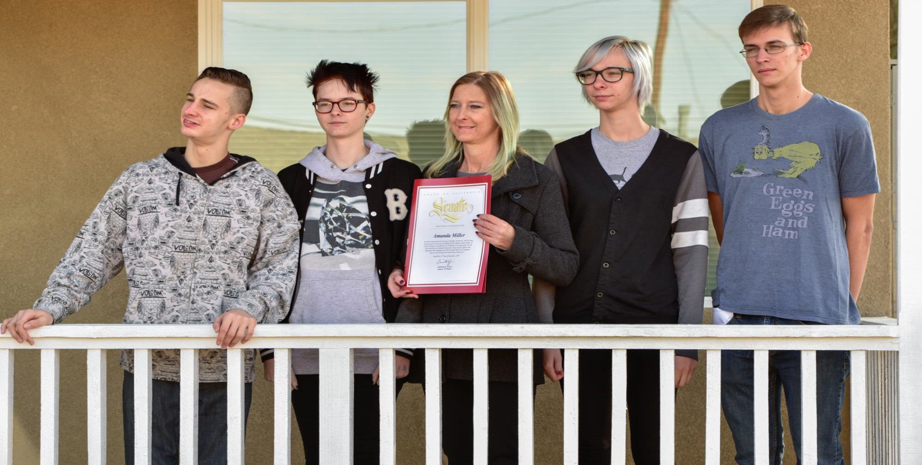
Would you like to be a Habitat homeowner?
We build strength, stability, and self-reliance through shelter.

Slide 2
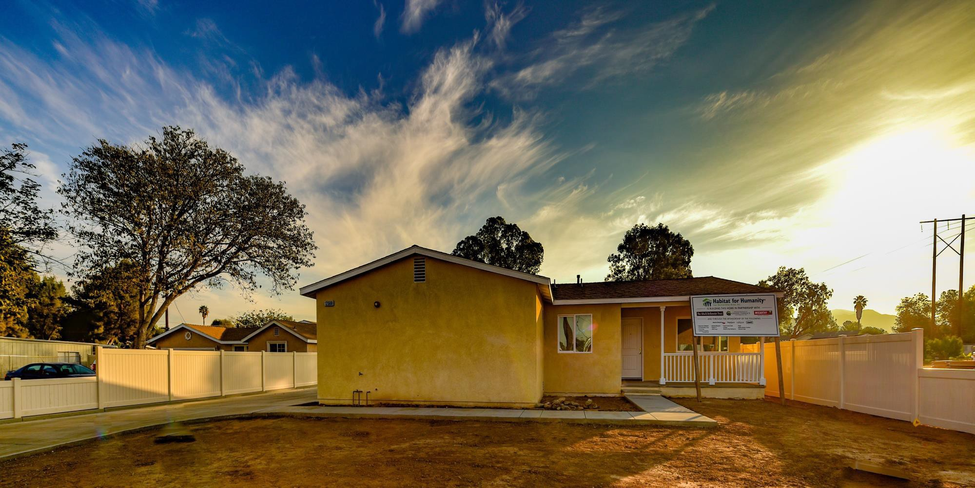
Are you ready for homeownership?
Renting vs. Owning
Signs of Readiness

Slide 3
Is renting or owning better for me?
RENTING
Less maintenance
No property taxes
Easier to relocate
Requires less $$ to move in
Lower insurance
More location options
OWNING
Build equity
Housing stability
Taxpayer voice
Community stability
Pet flexibility
Privacy and security
Decorating freedom

Slide 4
Am I ready to buy a home?
You may be ready if…
You believe that buying a home is right for you
You have the means to pay for and maintain a home
You are willing to learn how to manage your finances
You aren’t afraid of hard work
You find joy in achieving your goals

Slide 5
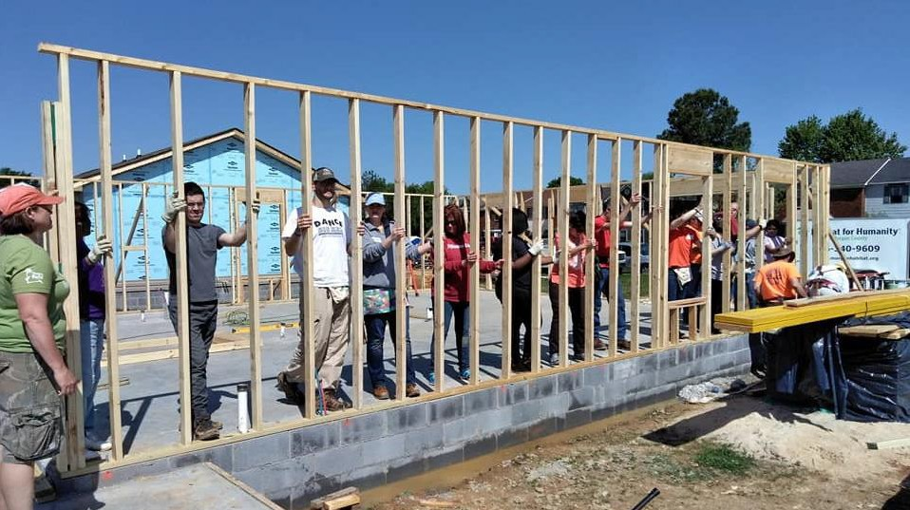
WHY BUY WITH HABITAT?
Partnering for Affordable Homeownership

Slide 6
Who We Are …
Habitat for Humanity is a nonprofit affordable housing builder and equal housing lender.
Our shared vision is a world where everyone has a decent place to live.
Through shelter, we empower.
Our Work…
People in your community and all over the world partner with Habitat for Humanity to build or improve a place to call home.
Habitat homeowners receive financial education, help build their own homes, and pay an affordable mortgage.

Slide 7
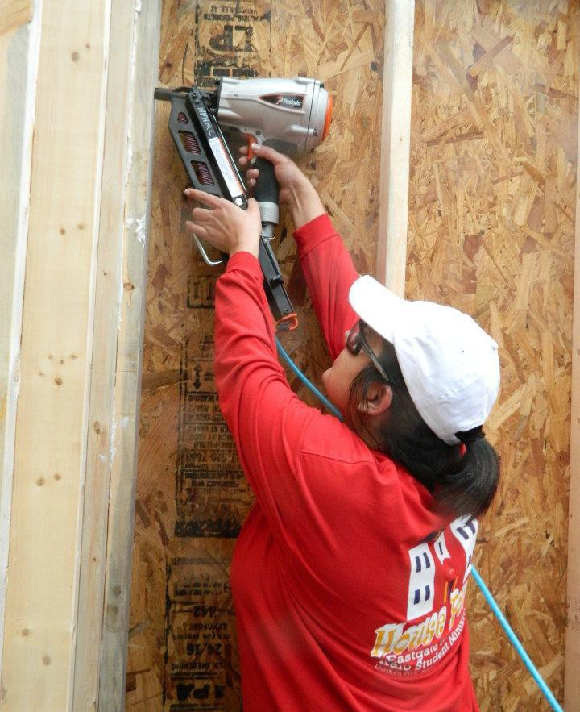
Habitat Homeownership Is…
PARTNERSHIP: future homeowners attend educational sessions, help build or improve homes for themselves and others
AFFORDABLE: mortgage payments are typically no more than 30% of buyers’ monthly income at time of purchase
EMPOWERING: an opportunity to build equity, stability, and self-reliance
RELIABLE: Habitat for Humanity San Bernardino has been building homes since 1992

Slide 8
Habitat Homes Are Not…
A SECOND HOME: buyers must meet the definition of first-time homebuyers and the home must be owner-occupied
AN INVESTMENT PROPERTY: restrictions prevent all or any part of the home to be rented
A WINDFALL OPPORTUNITY: restrictions affect resale options and sale price
A COMMERCIAL PROPERTY: restrictions limit the home’s use as a place of business

Slide 9
About our homes
Habitat for Humanity builds decent affordable homes that can serve as a stepping stone to your “dream home”
Homes are built to meet the essential needs of the household such as number of bedrooms, bathrooms, and accessibility features
You may have some choices for flooring, countertops, sidings, roofing, exterior paint/trim, depending on materials available

Slide 10
HOW DO I QUALIFY?
The Basic Requirements

Slide 11
Who can be a Habitat homeowner?
Habitat homeowners meet the definition of first-time homebuyers and demonstrate:
Need for adequate housing
Willingness to partner with Habitat
Ability to pay an affordable mortgage

Slide 12
What is Need for Adequate Housing?
You meet this requirement if:
Your current home is in poor condition
You are currently unhoused or living with family or friends
You live in subsidized housing
Your living arrangements are overcrowded
Your current home is inaccessible or dangerous
Your housing cost is more than 30% of your income
You or a member of your household has special needs

Slide 13
What is Ability to Pay?
To qualify for a Habitat mortgage, you must have:
A stable and reliable source of income
Debt that is not excessive relative to income
A history of on-time payments
NO current liens or judgments
NO recent bankruptcy

Slide 14
Are there income requirements?
Yes. Habitat serves low-income households. Maximum income limits are based on household size and include income from all adult household members
Household Size | 1 | 2 | 3 | 4 | 5 | 6 | 7 | 8
Maximum Income | $49,300 | $56,350 | $63,400 | $70,400 | $76,050 | $81,700 | $87,300 | $92,950
FY22 HUD gross income limits for Riverside-San Bernardino-Ontario Market Service Area (MSA). Revised annually.
Note: Buyers must meet minimum income requirements

Slide 15
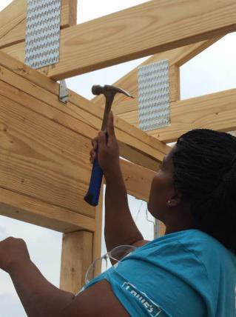
What is Willingness to Partner?
To meet this requirement, you agree to:
Help build or improve homes alongside volunteers
Attend homeowner education classes
Develop a budget & pay down debt
Maintain open communication with Habitat
Model, support, and promote Habitat’s work, mission, and core values: Humility, Courage, Accountability

Slide 16
How does Habitat partner with me?
Habitat is committed to successful homeownership. We will:
Teach you the skills to build, repair and maintain a house
Help you build your own and others’ homes
Provide education designed to help you build a better, healthier, and more financially stable life
Sell you a home with an affordable mortgage

Slide 17
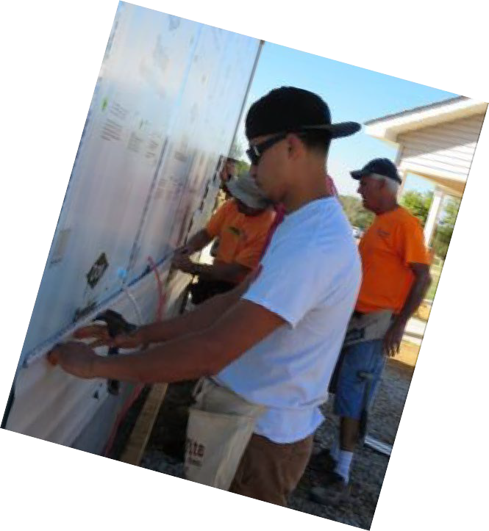
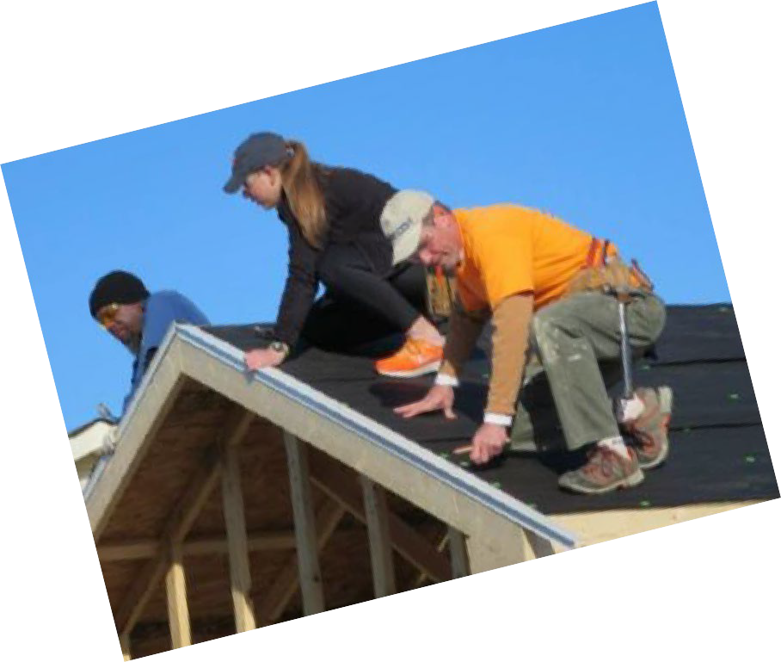
What is Sweat Equity?
Volunteer time spent building or improving homes with Habitat
Sweat equity must be completed before you can purchase a Habitat home
Sweat equity is calculated at 100 hours per adult household member at time of selection
Buyers are responsible for completing sweat equity; other adults in the household can help

Slide 18
Why do I need Homebuyer Education?
We want you to thrive in your new home
In homebuyer education you’ll learn about Habitat partnership and take classes on budgeting, leadership, home maintenance and repairs, communication, resolving conflict, protecting your investment, and receive HUD-approved housing counseling.
Habitat provides homeowner support pre- and post-purchase

Slide 19
Other considerations
If working, you must be with the same employer for at least 1 year
Citizenship or legal residency status may affect your eligibility for down payment or mortgage assistance
Depending on our funding partnerships, applicants who live or work in a certain city may be given preference
Everyone has a unique personal situation. For additional information or help, email at homeownership@habitatsb.org

Slide 20
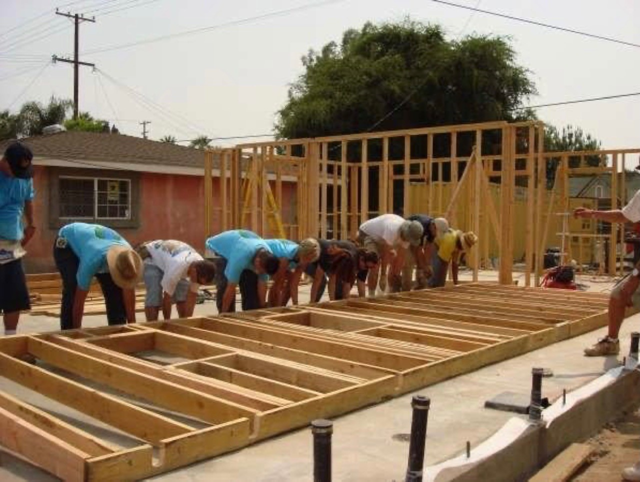
Before we get to the heavy lifting, time for a short break

Slide 21
APPLICATION & SELECTION
What happens next?

Slide 22
Application & Selection Process
Submit a
Pre-Application
Submit a Full
Application
Credit Review & Income Confirmation
Housing Conditions & Partnership Assessments
Final Screening, Approval, Partnership Agreement

Slide 23
Application & selection process – Part 1
Processing Order and Ability to Pay:
Pre-applications received are numbered, then randomized to determine processing order
Invitations to submit a full application along with payment for credit report are sent out
Creditworthiness is determined within 30 days
Ineligible applicants are notified in writing
Eligible applicants move on to Part 2

Slide 24
Application & selection process – Part 2
Need, Partnership, and Final Selection:
Additional documentation requested and reviewed
Assessments and investigative reports obtained and reviewed
When enough qualified applicants are found, a list is sent to the Board of Directors for final approval
Ineligible applicants are notified in writing
Selected homebuyers are notified in writing

Slide 25
Application Documents Checklist
If you are invited to submit a full application, you will need:
Completed Habitat Homeownership Program Application
Complete Federal and State Income Tax Returns (3 years)
Income Documentation for all adult household members (3 months)
Profit & Loss Statement if self-employed (3 months)
Copies of Legal Identification for all household members
Copy of Lease Agreement and proof of rent payments (3 months)
Copies of Utility Bills (3 months)
Copies of Statements for all bank and asset accounts (3 months)
Copy of divorce or custody papers, if applicable
Credit Report payment ($25 per person)
TIP: Know where to find all this information before you apply

Slide 26
If you are selected
You will receive a Partnership Packet that includes a written notice of conditional pre-approval and a Partnership Agreement
A Partnership Meeting is scheduled. After the Partnership Agreement is signed, you can begin sweat equity and homebuyer education
You will have regular meetings with Habitat to review your progress, answer your questions, and address important issues
You must maintain your eligibility to complete the Homeownership Program and purchase a Habitat home

Slide 27
Ready to apply?
Complete and return a pre-application form during an open application period
Check our website to see the randomization video and confirm your processing order number
If you are invited to apply you will have 14 days to submit a full application and credit report payment
Credit reports cost about $25/person
Criminal background checks cost about $35/person
TIP: Do not miss deadlines

Slide 28
Final Thoughts
Some families apply more than once before they become eligible or selected
We WANT to be partners with you. If your application is not approved, your notification letter will include the reason/s why and suggestions or referrals to help increase your eligibility
You can apply for the Habitat Homeownership program during any open application period
We recommend meeting with a HUD-certified housing counselor, especially if you are not currently eligible for our program

Slide 29
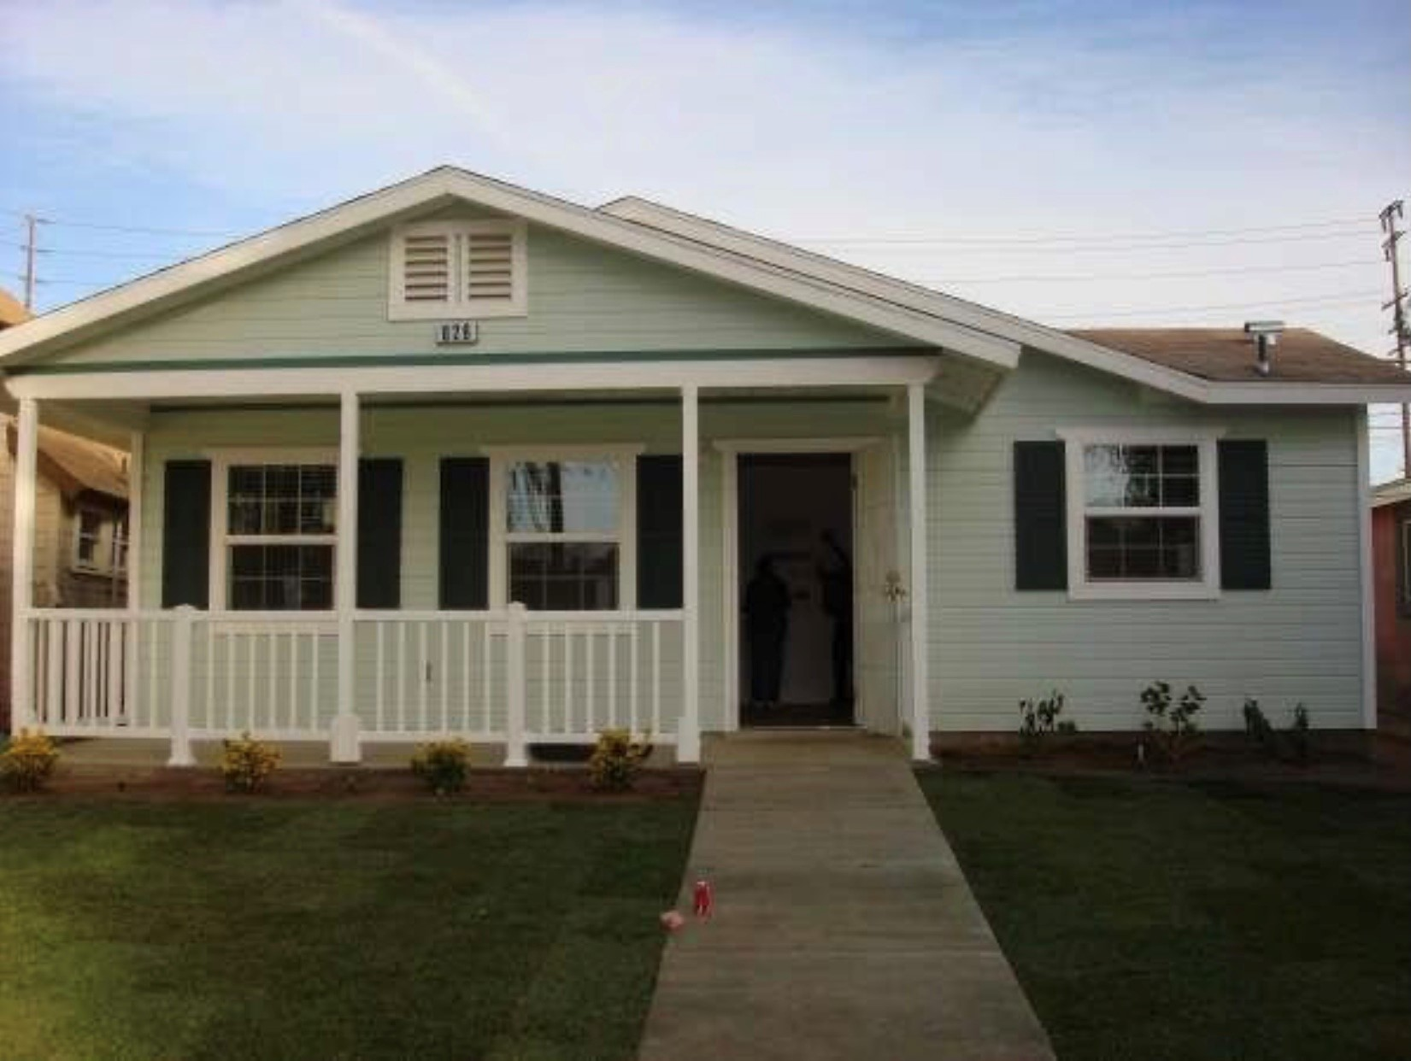
Questions?

Slide 30
Thank you for joining us!
Habitat for Humanity
San Bernardino Area
1426 Industrial Park Ave, Redlands CA 92374
Email: homeownership@habitatsb.org
Website: habitatsb.org
Phone: (909) 478-1176
HUD-Certified Housing Counseling available at
Inland Empire Resource Center Website: iercsb.org Phone: (909) 887-8700
We build strength, stability and self-reliance through shelter.

